Slide 1

Transformers 101
By: Himanshi Sinha & Elad Rapaport
Slides based on “The Illustrated Transformer” by Jay Allamar

Slide 2
What are Transformers?
A neural network architecture proposed in the 2018 paper “Attention is all you need”.
The paper took the ML community by storm with over 60,000 citations to date
Transformers have reached state-of-the-art performance on every data modality including text, images, time series and even tabular data
Recent popular products such as ChatGPT are heavily based on transformers.

Slide 3
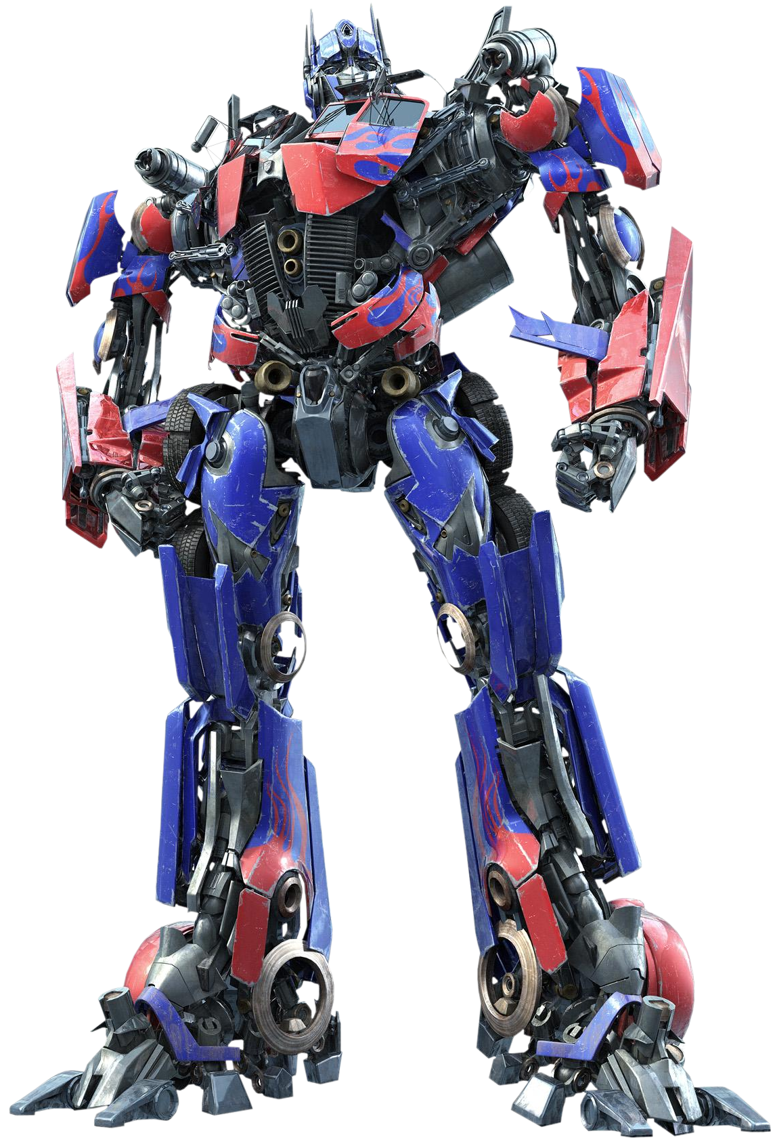
Our task for today
Machine Translation – French to English
Transformer
Input
Output
Je suis etudiant
I am a student

Slide 4

Translation in action

Slide 5

The Transformer Architecture
We will take the figure from the 2018 paper and build it step-by-step
student
Current output: student
The encoder stack
Decoder
The decoder stack
Encoder
Decoder
Encoder
Decoder
Encoder
Decoder
Encoder
Embedding layer
Embedding layer
Input: Je suis etudiant
Previous outputs: I am a

Slide 6
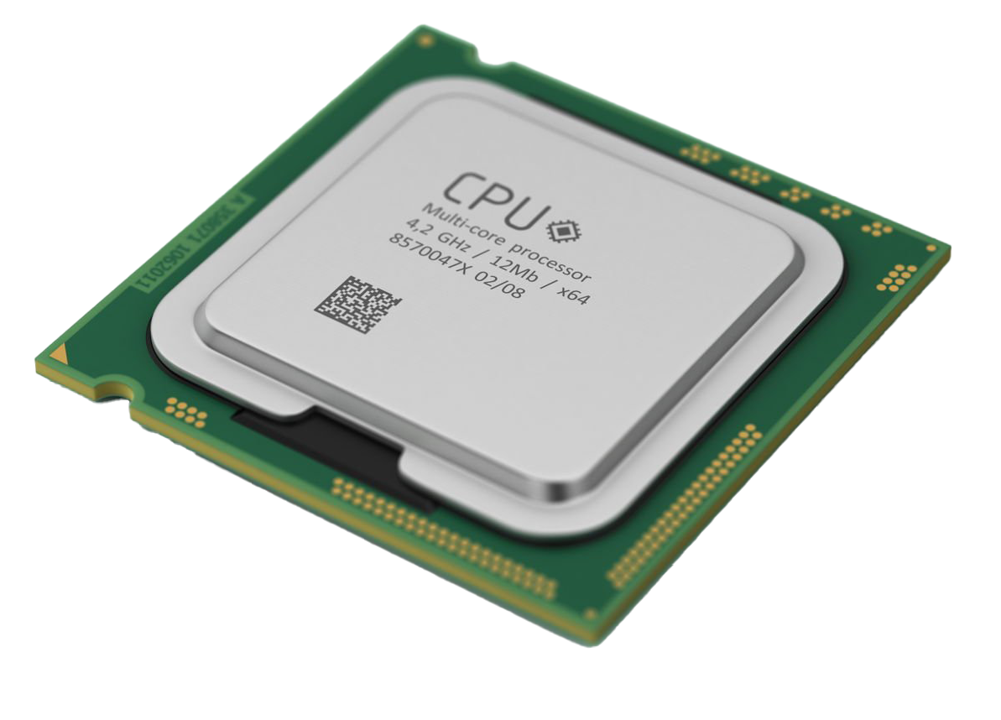
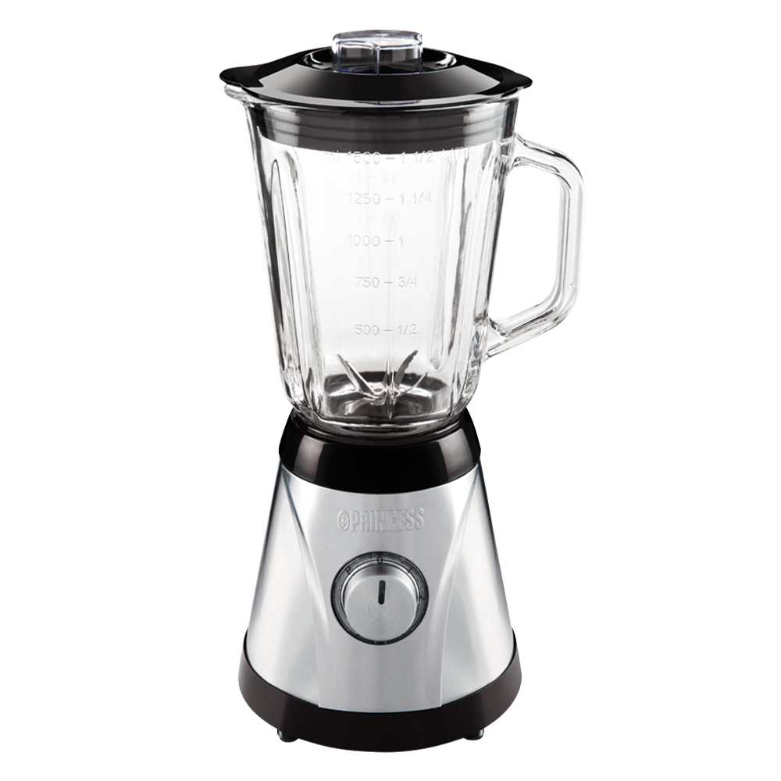
The Encoder up-close
Input to next encoder / decoder
Encoder
Feed-Forward Neural Network
Self-Attention
Initial input (Je suis etudiant)/Output from previous encoder - embedding

Slide 7
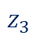
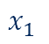
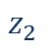
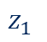
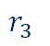
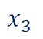
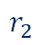
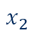
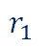
How does it look like with vectors?
Encoder #2
$$r_{1}$$
1.2 | 2.8 | 0.4 | 1.6
$$r_{2}$$
0.5 | 0.9 | 1.3 | 0.5
$$r_{3}$$
0.4 | 3.1 | 1.9 | 1.3
Encoder #1
FFN
FFN
FFN
$$z_{1}$$
3.1 | 1.2 | 0.2 | 0.1
$$z_{2}$$
1.2 | 0.6 | 2.6 | 2.4
$$z_{3}$$
0.8 | 3.3 | 2.2 | 0.9
Self-Attention
$$x_{1}$$
0.1 | 0.5 | 1.2 | 0.9
$$x_{2}$$
2.1 | 0.3 | 0.7 | 0.2
$$x_{3}$$
0.1 | 1.1 | 1.3 | 1.5
Je
suis
etudiant
Notes:
* Optional slide for long version

Slide 8

What is self-attention?
Take the following sentence – “The animal didn’t cross the street because it was too tired”
What does “it” refer to? How should the transformer know this?

Slide 9
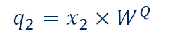

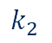
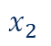
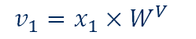
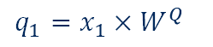

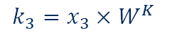
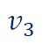
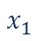
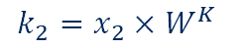
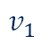
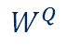
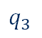
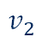
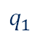
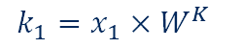
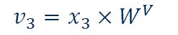
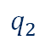
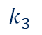

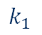
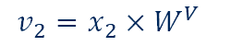
Let’s dive into self-attention
$$W^{Q}$$
Input
Je
suis
etudiant
0.8 | 1.1 | 3.2
0.9 | 0.2 | 1.4
1.8 | 1.3 | 2.1
0.8 | 1.7 | 1.3
Embedding
$$x_{1}$$
0.1 | 0.5 | 1.2 | 0.9
$$x_{2}$$
2.1 | 0.3 | 0.7 | 0.2
$$x_{3}$$
0.1 | 1.1 | 1.3 | 1.5
$$W^{K}$$
$$q_{1}=x_{1}×W^{Q}$$
$$q_{2}$$
1.3 | 0.1 | 0.4
0.4 | 2.5 | 2.1
0.9 | 1.1 | 0.4
0.9 | 1.3 | 2.3
$$q_{1}$$
$$q_{2}=x_{2}×W^{Q}$$
$$q_{3}$$
$$q_{3}=x_{3}×W^{Q}$$
Queries
0.1 | 0.5 | 1.2
3.4 | 3.6 | 8.9
4.6 | 4.6 | 6.5
$$k_{1}=x_{1}×W^{K}$$
$$k_{2}$$
$$k_{1}$$
$$k_{2}=x_{2}×W^{K}$$
$$k_{3}$$
$$k_{3}=x_{3}×W^{K}$$
Keys
2.2 | 3.7 | 3.6
3.7 | 2.0 | 2.2
3.1 | 6.1 | 6.3
$$W^{V}$$
0.4 | 1.3 | 2.2
1.1 | 1.0 | 0.6
0.8 | 2.3 | 0.2
0.3 | 0.7 | 1.1
Values
$$v_{1}$$
$$v_{1}=x_{1}×W^{V}$$
$$v_{2}$$
1.8 | 4.8 | 5.2
$$v_{3}$$
2.7 | 5.3 | 2.8
1.8 | 4.0 | 1.8
$$v_{2}=x_{2}×W^{V}$$
$$v_{3}=x_{3}×W^{V}$$
Contextual embedding = a representation that takes into account the other words in the sequence

Slide 10
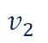
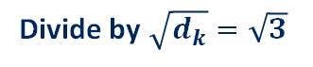

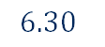

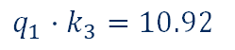

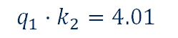
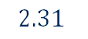
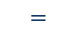
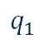
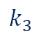
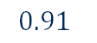
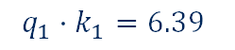
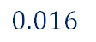

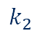
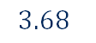
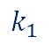
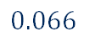

Let’s get the contextual embedding for “Je”
Input
Je
suis
etudiant
Embedding
$$x_{1}$$
0.1 | 0.5 | 1.2 | 0.9
$$x_{2}$$
2.1 | 0.3 | 0.7 | 0.2
$$x_{3}$$
0.1 | 1.1 | 1.3 | 1.5
Queries
$$q_{1}$$
0.1 | 0.5 | 1.2
$$q_{2}$$
3.4 | 3.6 | 8.9
$$q_{3}$$
4.6 | 4.6 | 6.5
Keys
$$k_{1}$$
2.2 | 3.7 | 3.6
$$k_{2}$$
3.7 | 2.0 | 2.2
$$k_{3}$$
3.1 | 6.1 | 6.3
Values
$$v_{1}$$
1.8 | 4.0 | 1.8
$$v_{2}$$
1.8 | 4.8 | 5.2
$$v_{3}$$
2.7 | 5.3 | 2.8
Score
$$q_{1}⋅k_{1}=6.39$$
$$q_{1}⋅k_{2}=4.01$$
$$q_{1}⋅k_{3}=10.92$$
Divide by $\sqrt{d_{k}}=\sqrt{3}$
$$3.68$$
$$2.31$$
$$6.30$$
Softmax
$$0.066$$
$$0.016$$
$$0.91$$
Softmax $⋅$ Value
0.11 | 0.26 | 0.12
$$+$$
0.03 | 0.08 | 0.08
$$+$$
2.45 | 4.8 | 2.54
$$=$$
Contextual embedding for “Je” - $z_{1}$
2.6 | 5.16 | 2.75
$$?$$
Notes:
Take questions here
* 15-minute mark

Slide 11


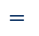






QKV as matrices
$$W^{Q}$$
$$X$$
$$Q$$
0.8 | 1.1 | 3.2
0.9 | 0.2 | 1.4
1.8 | 1.3 | 2.1
0.8 | 1.7 | 1.3
Je
0.1 | 0.5 | 1.2 | 0.9
2.1 | 0.3 | 0.7 | 0.2
0.1 | 1.1 | 1.3 | 1.5
Je
0.1 | 0.5 | 1.2
3.4 | 3.6 | 8.9
4.6 | 4.6 | 6.5
suis
$$×$$
$$=$$
suis
Queries
etudiant
etudiant
$$W^{K}$$
$$K$$
$$X$$
1.3 | 0.1 | 0.4
0.4 | 2.5 | 2.1
0.9 | 1.1 | 0.4
0.9 | 1.3 | 2.3
Je
0.1 | 0.5 | 1.2 | 0.9
2.1 | 0.3 | 0.7 | 0.2
0.1 | 1.1 | 1.3 | 1.5
Je
2.2 | 3.7 | 3.6
3.7 | 2.0 | 2.2
3.1 | 6.1 | 6.3
suis
$$×$$
$$=$$
suis
Keys
etudiant
etudiant
$$W^{V}$$
$$X$$
$$V$$
0.4 | 1.3 | 2.2
1.1 | 1.0 | 0.6
0.8 | 2.3 | 0.2
0.3 | 0.7 | 1.1
Je
0.1 | 0.5 | 1.2 | 0.9
2.1 | 0.3 | 0.7 | 0.2
0.1 | 1.1 | 1.3 | 1.5
Je
1.8 | 4.0 | 1.8
1.8 | 4.8 | 5.2
2.7 | 5.3 | 2.8
suis
$$×$$
$$=$$
suis
Values
etudiant
etudiant

Slide 12










QKV as matrices – getting contextual embeddings
$$Q$$
$$K^{T}$$
0.1 | 0.5 | 1.2
3.4 | 3.6 | 8.9
4.6 | 4.6 | 6.5
2.2 | 3.7 | 3.1
3.7 | 2.0 | 6.1
3.6 | 2.2 | 6.3
$$_______$$
$$×$$
softmaxed
$$V$$
$$)$$
$$Z$$
$$($$
0.07 | 0.02 | 0.91
0 | 0 | 1
0 | 0 | 1
Je
1.8 | 4.0 | 1.8
1.8 | 4.8 | 5.2
2.7 | 5.3 | 2.8
Je
2.6 | 5.16 | 2.75
2.7 | 5.3 | 2.8
2.7 | 5.3 | 2.8
$$Softmax$$
suis
$$×$$
$$=$$
suis
etudiant
$$\sqrt{3}$$
etudiant

Slide 13
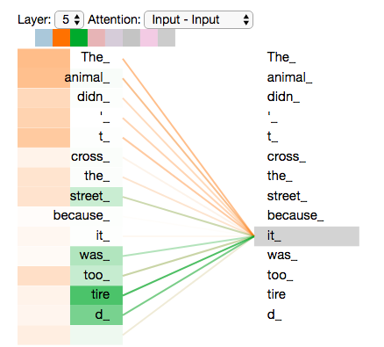
Multi-head attention - intuition
Remember the following sentence – “The animal didn’t cross the street because it was too tired”
Why should a certain word focus on only one part of the sentence?
Several “attentions” allow each word to focus on several areas in the sentence simultaneously

Slide 14


















Multi-headed attention – how it’s done
$$X$$
Je
0.1 | 0.5 | 1.2 | 0.9
2.1 | 0.3 | 0.7 | 0.2
0.1 | 1.1 | 1.3 | 1.5
suis
etudiant
Attention head #0
Attention head #1
Attention head #7
$$W_{0}^{Q}$$
$$W_{1}^{Q}$$
$$W_{7}^{Q}$$
$$Q_{0}$$
$$Q_{1}$$
$$Q_{7}$$
Queries
Queries
Queries
$$W_{0}^{K}$$
$$W_{1}^{K}$$
$$W_{7}^{K}$$
$$K_{0}$$
$$K_{1}$$
$$K_{7}$$
…
Keys
Keys
Keys
$$V_{0}$$
$$W_{0}^{V}$$
$$V_{1}$$
$$W_{1}^{V}$$
$$V_{7}$$
$$W_{7}^{V}$$
Values
Values
Values

Slide 15











How do we combine the attention heads?
$$X$$
Je
0.1 | 0.5 | 1.2 | 0.9
2.1 | 0.3 | 0.7 | 0.2
0.1 | 1.1 | 1.3 | 1.5
suis
etudiant
…
Attention head #0
Attention head #1
Attention head #7
concatenate
$$Z_{0}$$
$$Z_{1}$$
$$Z_{2}$$
$$Z_{3}$$
$$Z_{4}$$
$$Z_{5}$$
$$Z_{6}$$
$$Z_{7}$$
Je
suis
etudiant
$$×$$
$$W^{O}$$
$$=$$
$$Z$$
Je
suis
etudiant

Slide 16























Self-attention Recap
$$W_{0}^{Q}$$
$$W_{0}^{K}$$
$$Q_{0}$$
$$W_{0}^{V}$$
$$K_{0}$$
$$V_{0}$$
$$Z_{0}$$
$$=$$
$$W_{1}^{Q}$$
$$Z_{1}$$
$$W_{1}^{K}$$
$$Q_{1}$$
$$X$$
$$W_{1}^{V}$$
$$K_{1}$$
Je
$$Z$$
suis
$$=$$
$$V_{1}$$
Je
Je suis etudiant
$$×$$
$$×$$
$$W^{O}$$
$$=$$
etudiant
suis
…
etudiant
…
…
$$Z_{7}$$
$$W_{7}^{Q}$$
$$W_{7}^{K}$$
$$Q_{7}$$
$$W_{7}^{V}$$
$$K_{7}$$
$$=$$
$$V_{7}$$

Slide 17









Positional encoding
Notice that until now, our model was looking at a sentence as a bag of words
How do we consider the order of the words in a sentence?
…
…
The encoder stack
The decoder stack
Encoder #2
Decoder #2
Encoder #1
Decoder #1
Embedding with time signal
$$t_{1}$$
0.1 | 0.5 | 2.2 | 1.9
$$t_{2}$$
2.9 | 0.3 | 1.2 | 1.2
$$t_{3}$$
1.0 | 1.1 | 1.7 | 2.5
=
=
=
Positional encoding
$$p_{1}$$
$$p_{2}$$
$$p_{3}$$
0 | 1 | 0 | 1
0.8 | 0 | 0.5 | 1
0.9 | 0 | 0.4 | 1
+
+
+
Embeddings
$$x_{1}$$
0.1 | 0.5 | 1.2 | 0.9
$$x_{2}$$
2.1 | 0.3 | 0.7 | 0.2
$$x_{3}$$
0.1 | 1.1 | 1.3 | 1.5
Je
suis
etudiant
Notes:
30 minute mark for long version

Slide 18

Positional encoding (2)
Each token gets a unique pattern added to its embedding, depending on its position.
$$p_{1}$$
0 | 1 | 0 | 1
Notes:
* Optional slide for long version

Slide 19





Residuals + Layer Normalization (1)
The encoder stack
…
Encoder #2
Encoder #1
Add & Normalize
FFN
FFN
FFN
Add & Normalize
$$z_{1}$$
$$z_{2}$$
$$z_{3}$$
Self-Attention
Embedding with time signal
$$t_{1}$$
0.1 | 0.5 | 2.2 | 1.9
$$t_{2}$$
2.9 | 0.3 | 1.2 | 1.2
$$t_{3}$$
1.0 | 1.1 | 1.7 | 2.5
Je
suis
etudiant

Slide 20








Residuals + Layer Normalization (2)
The encoder stack
…
Encoder #2
Encoder #1
Add & Normalize
FFN
FFN
FFN
$$($$
$$)$$
LayerNorm
$$z$$
$$t$$
$$+$$
$$z_{1}$$
$$z_{2}$$
$$z_{3}$$
Self-Attention
Embedding with time signal
$$t_{1}$$
0.1 | 0.5 | 2.2 | 1.9
$$t_{2}$$
2.9 | 0.3 | 1.2 | 1.2
$$t_{3}$$
1.0 | 1.1 | 1.7 | 2.5
Je
suis
etudiant
Notes:
* Take questions here

Slide 21





The Decoder
$$K_{encdec}$$
Je
$$V_{encdec}$$
suis
The encoder stack
etudiant
The decoder stack
#2
#2
Add & Normalize
FFN
FFN
FFN
Add & Normalize
#1
Add & Normalize
Self-Attention
FFN
FFN
FFN
#1
Add & Normalize
$$q_{s}$$
Add & Normalize
<start>
FFN
FFN
FFN
Encoder-Decoder Attention
Add & Normalize
Add & Normalize
Self-Attention
Self-Attention
$$t_{1}$$
$$t_{2}$$
$$t_{3}$$
<start>
Je
suis
etudiant

Slide 22
















Encoder-decoder attention
Using the output of the last encoder
<start>
Je
suis
etudiant
Embedding
$$x_{1}$$
0.1 | 0.5 | 1.2 | 0.9
$$x_{2}$$
2.1 | 0.3 | 0.7 | 0.2
$$x_{3}$$
0.1 | 1.1 | 1.3 | 1.5
Query
$$q_{s}$$
0.1 | 0.5 | 1.2
Keys
$$k_{1}$$
2.2 | 3.7 | 3.6
$$k_{2}$$
3.7 | 2.0 | 2.2
$$k_{3}$$
3.1 | 6.1 | 6.3
Values
$$v_{1}$$
1.8 | 4.0 | 1.8
$$v_{2}$$
1.8 | 4.8 | 5.2
$$v_{3}$$
2.7 | 5.3 | 2.8
Score
$$q_{s}⋅k_{1}=6.39$$
$$q_{s}⋅k_{2}=4.01$$
$$q_{s}⋅k_{3}=10.92$$
Divide by $\sqrt{d_{k}}=\sqrt{3}$
$$3.68$$
$$2.31$$
$$6.30$$
Softmax
$$0.066$$
$$0.016$$
$$0.91$$
Softmax $⋅$ Value
0.11 | 0.26 | 1.8
$$+$$
0.03 | 0.08 | 0.08
$$+$$
2.45 | 4.8 | 2.54
$$=$$
$$z_{s}=$$
2.6 | 5.16 | 2.75
Notes:
* Optional slide for long version

Slide 23
The Decoder
$$K_{encdec}$$
Je
$$V_{encdec}$$
suis
The encoder stack
etudiant
The decoder stack
#2
#2
FFN
FFN
FFN
Self-Attention
#1
#1
FFN
FFN
FFN
#0
Self-Attention
$$q_{s}$$
<start>
FFN
FFN
FFN
#0
Encoder-Decoder-Attention
FFN
FFN
FFN
Self-Attention
Self-Attention
$$t_{1}$$
$$t_{2}$$
$$t_{3}$$
Je
suis
etudiant
<start>

Slide 24
Linear + Softmax Layers
Which word in our vocabulary is associated with that index?
giraffe
Get index of cell with highest value (argmax)
5
probabilites
0 1 2 3
vocab_size
Softmax
logits
0 1 2 3
vocab_size
Linear
Output of the last word in the decoder
Notes:
* Optional slide for long version

Slide 25
Loss Function
Ground truth
0 | 1 | 0 | 0 | 0
am
student
giraffe
I
a
Probabilites
(output of decoder)
0.1 | 0.3 | 0.5 | 0.05 | 0.05
am
student
giraffe
I
a
Cross entropy: $−\log\left(p\left(student\right)\right)=−\log\left(0.3\right)=0.52$
Notes:
* Optional slide for long version

Slide 26
Summary – Translation in action

Slide 27
Additional Material
The Illustrated Transformer – Jay Alammar – Visualizing machine learning one concept at a time. (jalammar.github.io)
A Gentle Introduction to Positional Encoding in Transformer Models, Part 1 - MachineLearningMastery.com
[1706.03762] Attention Is All You Need (arxiv.org)

Slide 28


